Slide 1
3D Reconstruction of Notre Dame Cathedral
By Karan Ahuja
Under the guidance of dr. Mathieu aubry

Slide 2
1st Attempt - OpenCV
OpenCV 3.1 has some 3D Scene Reconstruction and Structure from motion modules. But most of them require the camera intrinsic (f, cx and cy) to be known. These functions generate a sparse point cloud and a beta version of them is available.
Therefore auto calibration is required before proceeding. This can be done from the Kruppa Equations for solving the fundamental matrix with N-View Constraints. More information about this can be found at this link. However, it is also stated that intrinsic parameters are recovered with fair but not excellent accuracy.
Also most OpenCV methods currently available use only stereo block matching methods for 3D reconstruction using epipolar geometry techniques to generate depth maps.

Slide 3
Pipeline for 3D Reconstruction using OpenCV Stereo Matching
LEARNING the concepts

Slide 4
Start with multiple views of a scene.
Extract SURF/SIFT/ORB key points from images.
Find interesting points.
Pair-wise matching of images.
Simultaneously solve for good matches and F (fundamental matrix) using RANSAC.
Incorporate additional knowledge (camera internal calibration, known angles, planes, etc.) to upgrade uncalibrated F to E.
Guess K matrix and then calculate essential matrix. [Hartley]
Assumptions made for calculating K:
No skew
Optical Center is at the center of the image
Decompose E to find R and t.
Use R and t, along with point correspondences, to triangulate the real-world 3D positions of the sparse feature points.
P corresponds to the epipole of the intersection of the epilines

Slide 5
Bundle adjustment of pose and 3D points.
Optimize over the entire set by minimizing re-projection error:
where
Repeat for multiple images and combine point clouds using Iterative Closest Point.
Get desired dense depth map, using known epipolar constraints to constrain correspondence and use stereo (per-point triangulation).
OpenCV function Block Chain
Detect Key points and extract descriptors (SURF/SIFT)
Compare and Match Descriptors (Flann/Brute Force)
findFundamentalMat()
stereoRectifyUncalibrated()
reprojectImageTo3D()

Slide 6
Challenges
Current openCV module only supports 3D reconstruction using disparity maps from stereo left and right images and require the images to be the same sizes. Although the images can be resized, it leads to considerable loss of information and aspect ratio for low resolution images. It use Block Matching Algorithm instead of a feature matching one.
StereoRectifyUncalibrated calculates simply planar perspective transformation not rectification transformation in object space. It is necessary to convert this planar transformation to object space transformation to extract K matrix.
OpenCV does not provide a module for ICP in it’s stable version and ICP can introduce scale ambiguity which need to be refined using Bundle Adjustment.
Solution: Instead of implementing these functions in OpenCV use a software tool that already performs it and implement later/ or contribute to openCV 3.1 Sfm module.

Slide 7
VisualSFM and CMVS
Using visualsfm for sparse reconstruction and Cmvs for dense reconstruction – using meshlab to visualize

Slide 8


Attempt 1 – Taking Recent Photos
8 pairs have two-view models
8 pairs have fundamental matrices
2 cameras used for reconstruction
1 model generated
Total 670 3D vertices generated after Dense Reconstruction
Increasing the number of 3D vertices detected by changing some VisualSFM settings:
Changing minimum inlier matches for a pair to be considered correct from 15 to 10.
Setting VisualSFM to output 1 Model and Merge two models if 3D matches is greater than 20
7 pairs have two-view models
7 pairs have fundamental matrices
2 cameras used for reconstruction
1 model generated
Total 904 3D vertices generated after Dense Reconstruction
Due to the low resolution of the images the reconstructed 3D image does not have many image points. This is because very less features are detected and matched.
A better result is obtained, let’s explore if tuning the parameters further gives a better result

Slide 9

Attempt 1 – Continued
Changing threshold for the number of projections when adding a new camera from 20 to 12 and that for pose estimation from 64 to 40.
7 pairs have two-view models
7 pairs have fundamental matrices
4 cameras used for reconstruction
Total 1462 3D vertices generated after Dense Reconstruction
All the methods to improve results till now have been done by changing VisualSfm parameters. Let’s see how to further better them by:
Adding a better feature matching algorithm (VisualSFM uses Multi-threaded match). Let’s see if using a Flann or Brute Force may give better results.
Increasing the data size for running SFM by manipulating the current one.
Training an Histogram of Gradients based object detector to extract the features of Notre Dame Cathedral only.

Slide 10

Attempt 2
VisualSFM lets you add the key points you want to match for achieving Sparse Reconstruction. Let’s try to a simple Flann or Brute Force Matcher on the images. You have to input the 0-based feature indices for customized matching. The inlier condition of greater than 10 is used.
4 cameras used for reconstruction
Total 1358 3D vertices generated after Dense Reconstruction
Therefore, there is not much difference and the multithreaded feature matching
of VisualSFM proves to be better and faster.

Slide 11
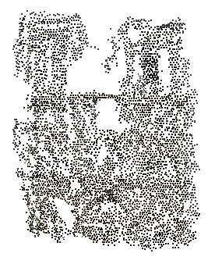

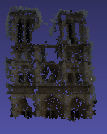
Attempt 2 - Continued
Now to increase the data size I use Laplacian Pyramid to upscale the image and then I flip it to obtain it’s mirror image. This is a common technique (mirroring of image) used to train Active Appearance Models with more sets.
29 pairs have two-view models
44 pairs have fundamental matrices
3 cameras used for reconstruction
Total 5332 3D vertices generated after Dense Reconstruction
- 4 times increase compared to attempt 1
Input:
Orig_Img
Flip(LaplacianUp(Orig_Img))

Slide 12
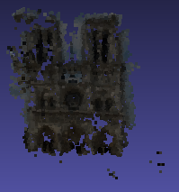
97 pairs have two-view models
174 pairs have fundamental matrices
14 cameras used for reconstruction
Total 6924 3D vertices generated after Dense Reconstruction
It’s evident that due to high scaling image quality decreases (blurred).
To further increase the robustness of the 3D reconstruction a Histogram
of Gradients based detector should be employed to detect Notre
Dame Cathedral. [Future Work]
This is because many features are not matched due to:
Change in scale and orientation
Change of illumination (night/day)
Detection of common non-essential repetitive patterns such as lamps and benches.
Various occlusions such as trees, people, etc.…. .
Using a detector may be able to take care of (a), (b) and (c).
Input:
Orig_Img
LaplacianUp(Orig_Img))
Flip(LaplacianUp(Orig_Img))

Slide 13

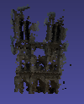
Attempt 3 – Taking All Photos
Load the images in gray scale format and perform histogram equalization on the historical images set, to enhance the contrast. Now using Visual SFM for 3D reconstruction using old settings:
10 pairs have two-view models
10 pairs have fundamental matrices
4 cameras used for reconstruction
Total 1325 3D vertices generated after Dense Reconstruction
Without histogram equalization only 1050 points are generated
Output:
35 pairs have two-view models
47 pairs have fundamental matrices
6 cameras used for reconstruction
Total 4682 3D vertices generated after Dense Reconstruction
Input:
Orig_Img
Flip(LaplacianUp(Orig_Img))

Slide 14
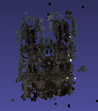
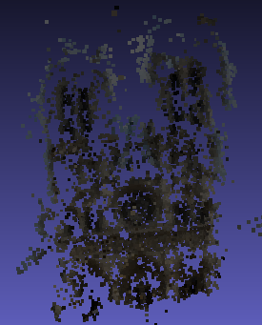
88 pairs have two-view models
209 pairs have fundamental matrices
14 cameras used for reconstruction
Total 5176 3D vertices generated after Dense Reconstruction
It should be noted that adding of historical
images does not bring about much change
in the number of 3D vertices generated.
In fact the number of points were more for the
recent images as compared to the combination of the two. This occurs because many of the historical images contribute less/none to the matching of key points. Hence, a proper mechanism is needed to extract these points.
Input:
Orig_Img
LaplacianUp(Orig_Img))
Flip(LaplacianUp(Orig_Img))

Slide 15
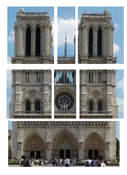
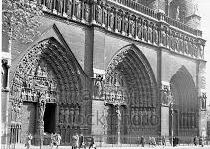
To do list
Train a HoG detector to detect Notre Dame de Paris. Also see if segregating the detected monument and segregating it into different parts and then matching those parts with dynamic resizing helps.
Convert the dense reconstruction to a mesh.
Better understand CMVS and PMVS, and read more on dense reconstruction. Also further understand the finer details of rendering transitions.
Compare the different 3D Point Clouds with that of a standard high res one of Notre Dame.
The motivation for this is that even though better details can be obtained from the pictures only containing some parts, adequate feature matching does not occur between them.

Slide 16
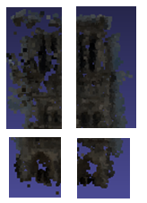
To do list
Use OpenMVG to further understand the various types of SFM solving methods. Also see if using SURF/ORB and a better feature matching algorithm gives a better result. This can’t be tested on VisualSFM as it requires SIFT key points.
See if symmetry of the detected building can be exploited for a better reconstruction. For example:
It is evident that the right tower of the cathedral
gives better results than the left and lower left part of
the Notre Dame gives better results than that of the right.
Therefore, it would be interesting to see if we can combine and
mutually rectify both of them based on their symmetry.

Slide 17
References
http://www.theia-sfm.org/sfm.html
http://grail.cs.washington.edu/projects/mvscpc/
http://www.cs.cornell.edu/~snavely/bundler/
http://phototour.cs.washington.edu/
http://ccwu.me/vsfm/
http://www.di.ens.fr/cmvs/
Structure from Motion – Bryan S. Morse (CS 650)
http://docs.opencv.org/3.0-beta/doc/py_tutorials/py_calib3d/py_epipolar_geometry/py_epipolar_geometry.html
http://docs.opencv.org/2.4/modules/calib3d/doc/camera_calibration_and_3d_reconstruction.html
http://openmvg.readthedocs.org/en/latest/software/SfM/SfM/
http://stackoverflow.com/questions/21855335/structure-from-motion-from-multiple-views

